Slide 1
Unix Basics

Slide 2
Unix Accounts
One must have an “account” to use a Unix computer.
  To share resources, need to tell users apart.
You can only access the resources that are specified by your account information.
  Accounts track, control, and limit user activity.
There is at least one super user account in a system usually named “root”, who has absolute power over the system. (On Microsoft Windows NT/2000/XP, this account is usually named
“administrator”.)

Slide 3
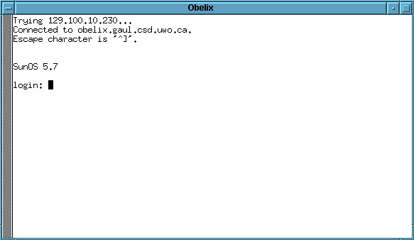
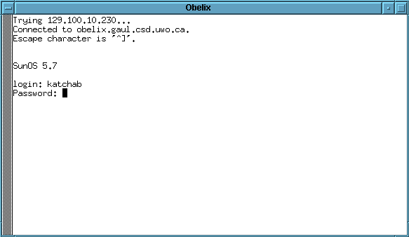
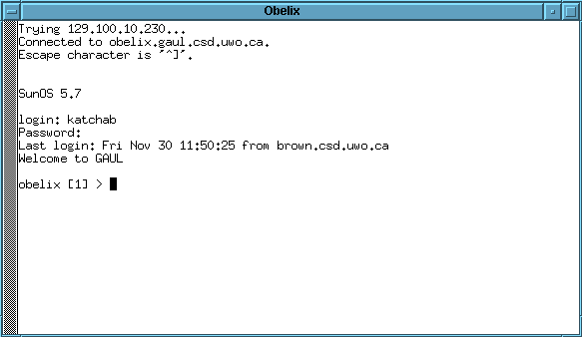
Login to Your Account
User name
Password is not displayed.
Greetings from Unix.
Cursor
Prompt

Slide 4
Login to Your Account from Home
Most Unix computers support remote login.
  Unless it is deliberately turned off.
  ssh protocol
You need
  Internet access
  A ssh client program.
    ssh (unix)
    putty (windows)

Slide 5
To Make a Good Password
A good password
  Easily remembered by YOU
  Difficult to be guessed by others
Tricks to make a good password
  Pick letters from a sentence
    I love Unix → Ioenx
  Pick letters, numbers, and symbols that
  sound, look like, or replace a phrase
    I hate carrots! → ih8^s!
A bad password not only harms you
  Attacks are much easier with a compromised account on a computer

Slide 6
Log out
When you’re done, don’t forget to logout!!!!!!!
obelix > exit
obelix > logout

Slide 7
Some Basic Commands
who: Who are using the system.
obelix > who
katchab ttyp0 Aug 11 08:47
scott tty02 Aug 10 11:01
jenny tty03 Aug 10 07:21
whoami: Who am I?
obelix > whoami
katchab

Slide 8
Some Basic Commands
ls: List the files under current directory
obelix > ls
readme cs211.2.ppt cs211.ppt.gz notes.zip
cs211.1.ppt cs211.3.ppt make/ shell/
cat: Display the content of a file
obelix > cat readme
Unix is easy!
obelix >

Slide 9
Some Basic Commands
Ctrl-c: Interrupt the current task.
obelix > cat
^c
obelix >
netscape: surf the net.
obelix > netscape
lynx: surf the net.
obelix > lynx www.yahoo.com

Slide 10
Some Basic Commands
man: See the manual page of a command.
xman: Graphical, X-Windows version
obelix > man cat
Reformatting page. Wait... Done
User Commands cat(1)
NAME cat - concatenate and display files
SYNOPSIS cat [ -nbsuvet ] [ file ... ]
DESCRIPTION
cat reads each file in sequence and writes it on the stan-
dard output. Thus:
example% cat file
prints file on your terminal, and:
example% cat file1 file2 >file3
concatenates file1 and file2, and writes the results in
file3. If no input file is given, cat reads from the stan-
dard input file.
OPTIONS--More--(11%)

